Slide 1
Toolbox
Open file dialog
Page setup dialog

Slide 2

Open File Dialog :
1. OpenFileDialog control allows us to browse and select files on a computer in an
application.
2. We can create an OpenFileDialog control using a Forms designer at design-time or using the OpenFileDialog class in code at run-time (also known as dynamically).
Design Time:
Go to ToolBox And Search For Open File Dialog
Drag and Drop the Open File Dialog From There.

Slide 3
Run Time:
We can create a openfileDialog during Run-time by creating an instance to the OpenFileDialog Class.
Create Object:
OpenFileDialog openFileDialog1 = new OpenFileDialog();
Show method :
It displays OpenFileDialog.
openFileDialog1.ShowDialog();

Slide 4
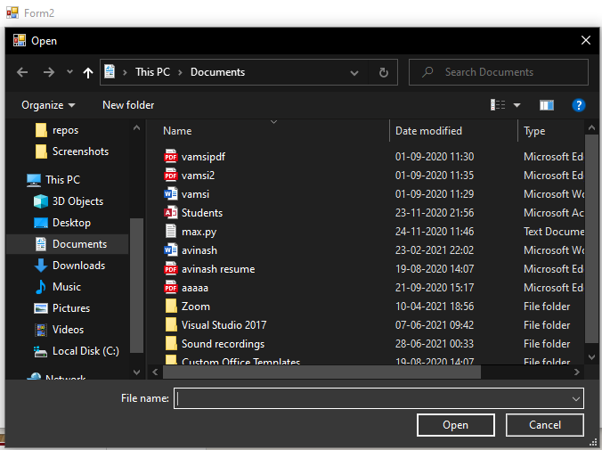
Output :

Slide 5

Page Setup Dialog :
1.Page setup dialog allows us to modify the page settings and printer settings.
2.It allows the Users to manipulate the page Margins,Oreintation and size of
the pages.

Slide 6
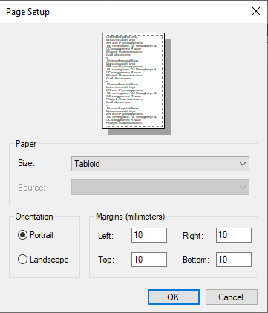
Output :

